Slide 1
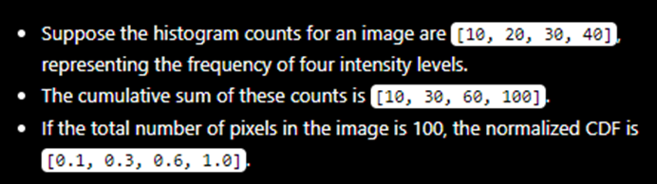
Global Histogram Equalization
Get pixel counts with imhist
Calculate CDF with cumsum
Normalize it by dividing with total pixel count
Remap with CDF
Scale remapped image with 255
Add 1!
Reshape

Slide 2
Local Histogram Equalization
Pad image (symmetrical padding)
Init output image
Go through each pixel
Get local region according to window size
Override pixel with center pixel of equalized local window

Slide 3
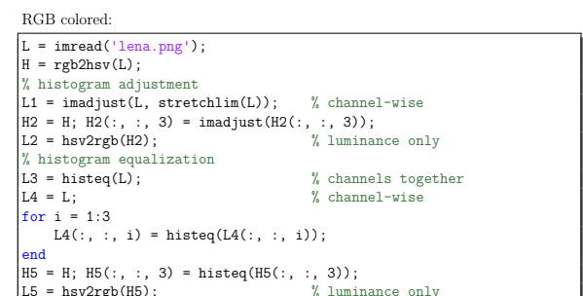
RGB Images
Convert to HSV color space
Get luminance channel
Same process as with gray images
Replace luminance and convert back

Slide 4
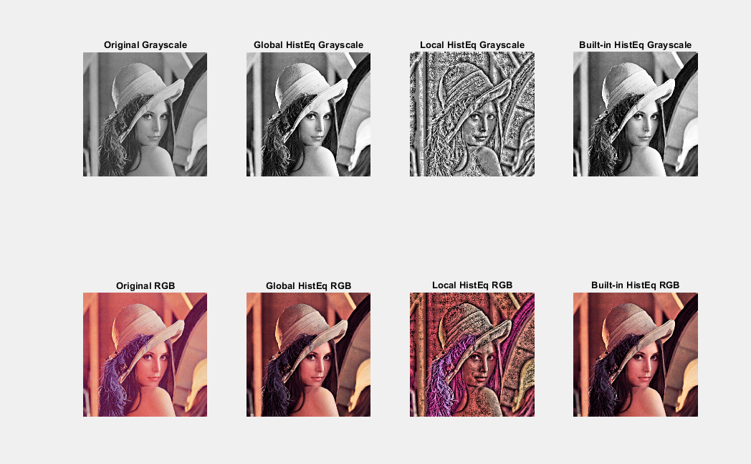

Slide 5
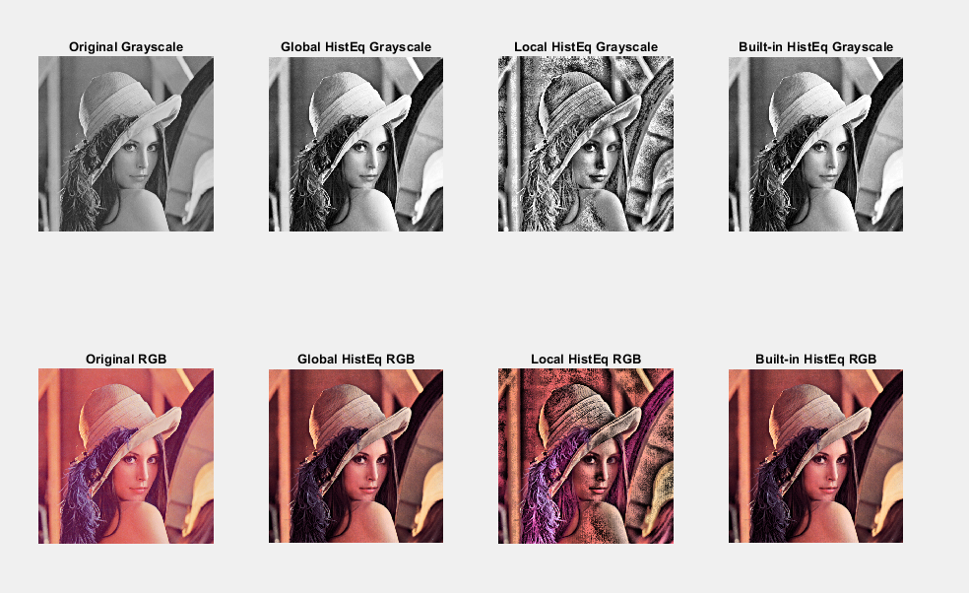

Slide 6
